Slide 1
PHOTO COVER OPTION
TITLE GOES HERE CAN
RUN THREE LINES
SUBTITLE STYLE GOES HERE, CAN RUN FOUR LINES

Slide 2
RED COVER OPTION
TITLE GOES HERE CAN RUN THREE LINES
SUBTITLE STYLE GOES HERE,
CAN RUN FOUR LINES

Slide 3
DIVIDER TITLE GOES HERE & CAN RUN SEVERAL LINES

Slide 4

TITLE GOES HERE
& CAN RUN
THREE LINES
Level 1 bullet goes here.
  Level 2 bullet goes here.

Slide 5
TRANSFORMATIONS FOR VARIANCE STABILIZATION
F O R EC A S T I N G I N R
Z a hid A sg ha r
Professor, School of Economics, QAU

Slide 6
VARIANCE STABILIZATION
If the data show increasing variation as the level of the series increases, then a transformation can be useful
y₁, ..., y_{n}: original observations, w₁, ..., w_{n}: transformed observations
Square root | w_{t} = √y_{t} | ↓
Cube root | w_{t} = √³ y_{t} | Increasing
Logarithm | w_{t} = log(y_{t}) | Strength
Inverse | w_{t} = −1/y_{t} | ↓

Slide 7
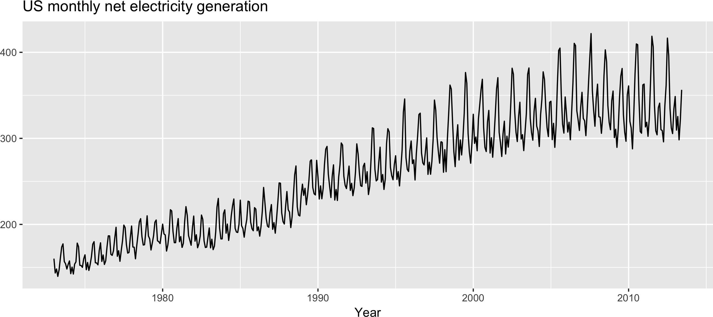
VARIANCE STABILIZATION
autoplot(usmelec) + xlab("Year") + ylab("") +
ggtitle("US monthly net electricity generation")

Slide 8
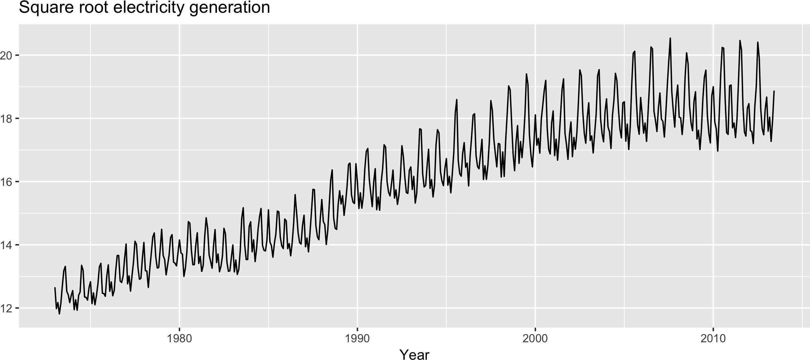
VARIANCE STABILIZATION
autoplot(usmelec^0.5) + xlab("Year") + ylab("") +
ggtitle("Square root electricity generation")

Slide 9
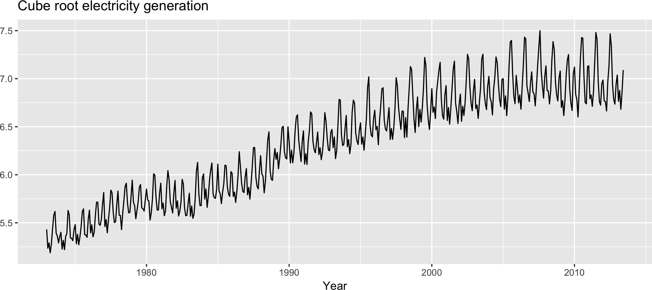
VARIANCE STABILIZATION
autoplot(usmelec^0.33333) + xlab("Year") + ylab("") +
ggtitle("Cube root electricity generation")

Slide 10
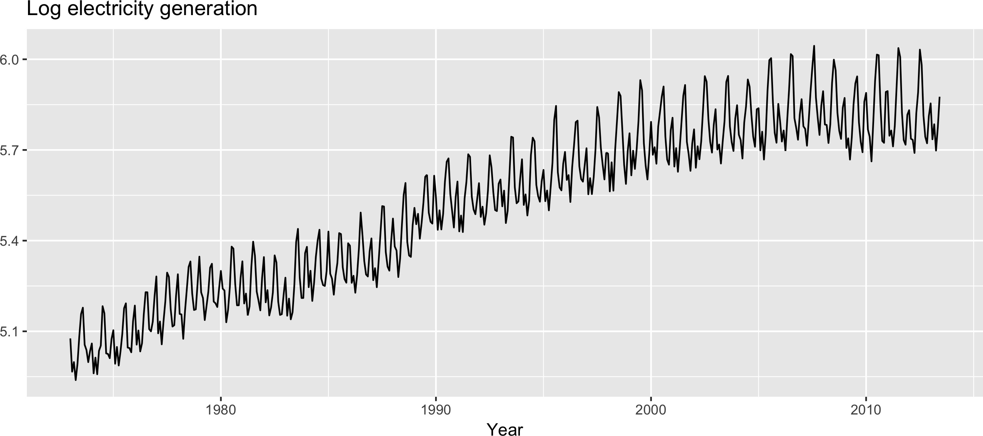
VARIANCE STABILIZATION
autoplot(log(usmelec)) + xlab("Year") + ylab("") +
ggtitle("Log electricity generation")

Slide 11
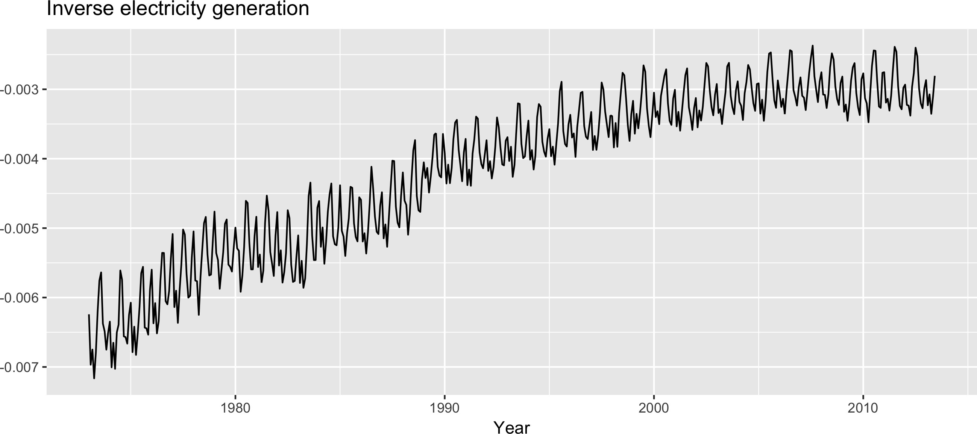
VARIANCE STABILIZATION
autoplot(-1/usmelec) + xlab("Year") + ylab("") +
ggtitle("Inverse electricity generation")

Slide 12
BOX-COX TRANSFORMATIONS
Each of these transformations is close to a member of the family of Box-Cox transformations
λ = 0 (y^{λ} − 1)/λ λ ≠ 0
log(y )
w = {
t
λ = 1 : No substantive transformation
λ = ¹ : Square root plus linear transformation
2
λ is = ¹ : Cube root plus linear transformation
3
λ = 0 : Natural logarithm transformation
λ = −1 : Inverse transformation

Slide 13
BOX-COX TRANSFORMATIONS
BoxCox.lambda(usmelec)
-0.5738331

Slide 14
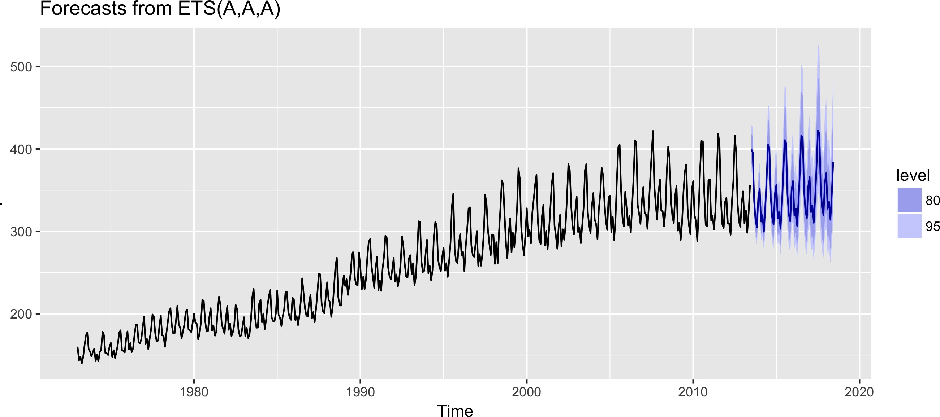
BACK-TRANSFORMATION
usmelec %>%
ets(lambda = -0.57) %>% forecast(h = 60) %>% autoplot()

Slide 15
Let's practice!
F O R EC A S T I N G I N R

Slide 16
ARIMA MODELS
F O R EC A S T I N G I N R
Z a hid A sg ha r
Professor, School of Economics, QAU

Slide 17
ARIMA MODELS
Autoregressive (AR) models:
Multiple regression with lagged observations as predictors
y_{t} = c + ϕ₁y_{t−1} + ϕ₂y_{t−2} + ... + ϕ_{p}y_{t−p} + e_{t}
Moving average (MA) models:
Multiple regression with lagged errors as predictors
y_{t} = c + θ₁e_{t−1} + θ₂e_{t−2} + ... + θ_{q}e_{t−q}

Slide 18
ARIMA MODELS
Autoregressive moving average (ARMA) models:
Multiple regression with lagged observations and errors as predictors
y_{t} = c + ϕ₁y_{t−1} + ... + ϕ_{p}y_{t−p} + θ₁e_{t−1} + ... + θ_{q}e_{t−q} + e_{t}
ARIMA(p, d, q) models:
Combine ARMA model with d - lots of di erencing

Slide 19
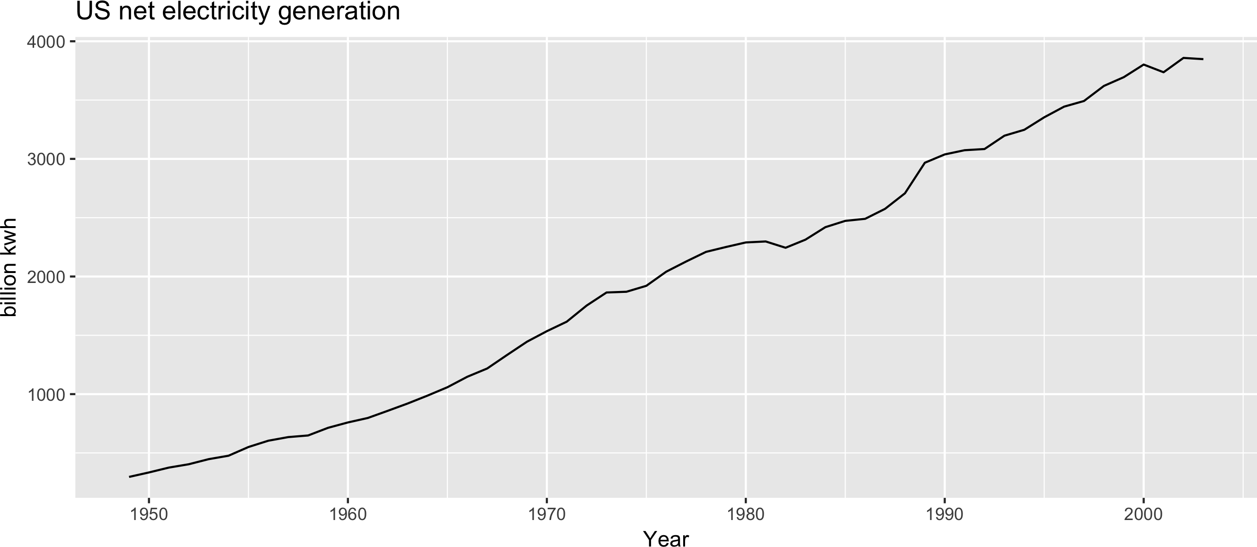
US NET ELECTRICITY GENERATION
autoplot(usnetelec) + xlab("Year") + ylab("billion kwh") +
ggtitle("US net electricity generation")

Slide 20
US NET ELECTRICITY GENERATION
fit <- auto.arima(usnetelec) summary(fit)
Series: usnetelec
ARIMA(2,1,2) with drift
Coefficients:
ar1
-1.303
0.212
ar2
-0.433
0.208
ma1 ma2 1.528 0.834
0.142 0.119
drift 66.159
7.559
s.e.
sigma^2 estimated as 2262: log likelihood=-283.3 AIC=578.7 AICc=580.5 BIC=590.6
Training set error measures:
ME RMSE MAE MPE MAPE MASE ACF1 Training set 0.0464 44.89 32.33 -0.6177 2.101 0.4581 0.02249

Slide 21
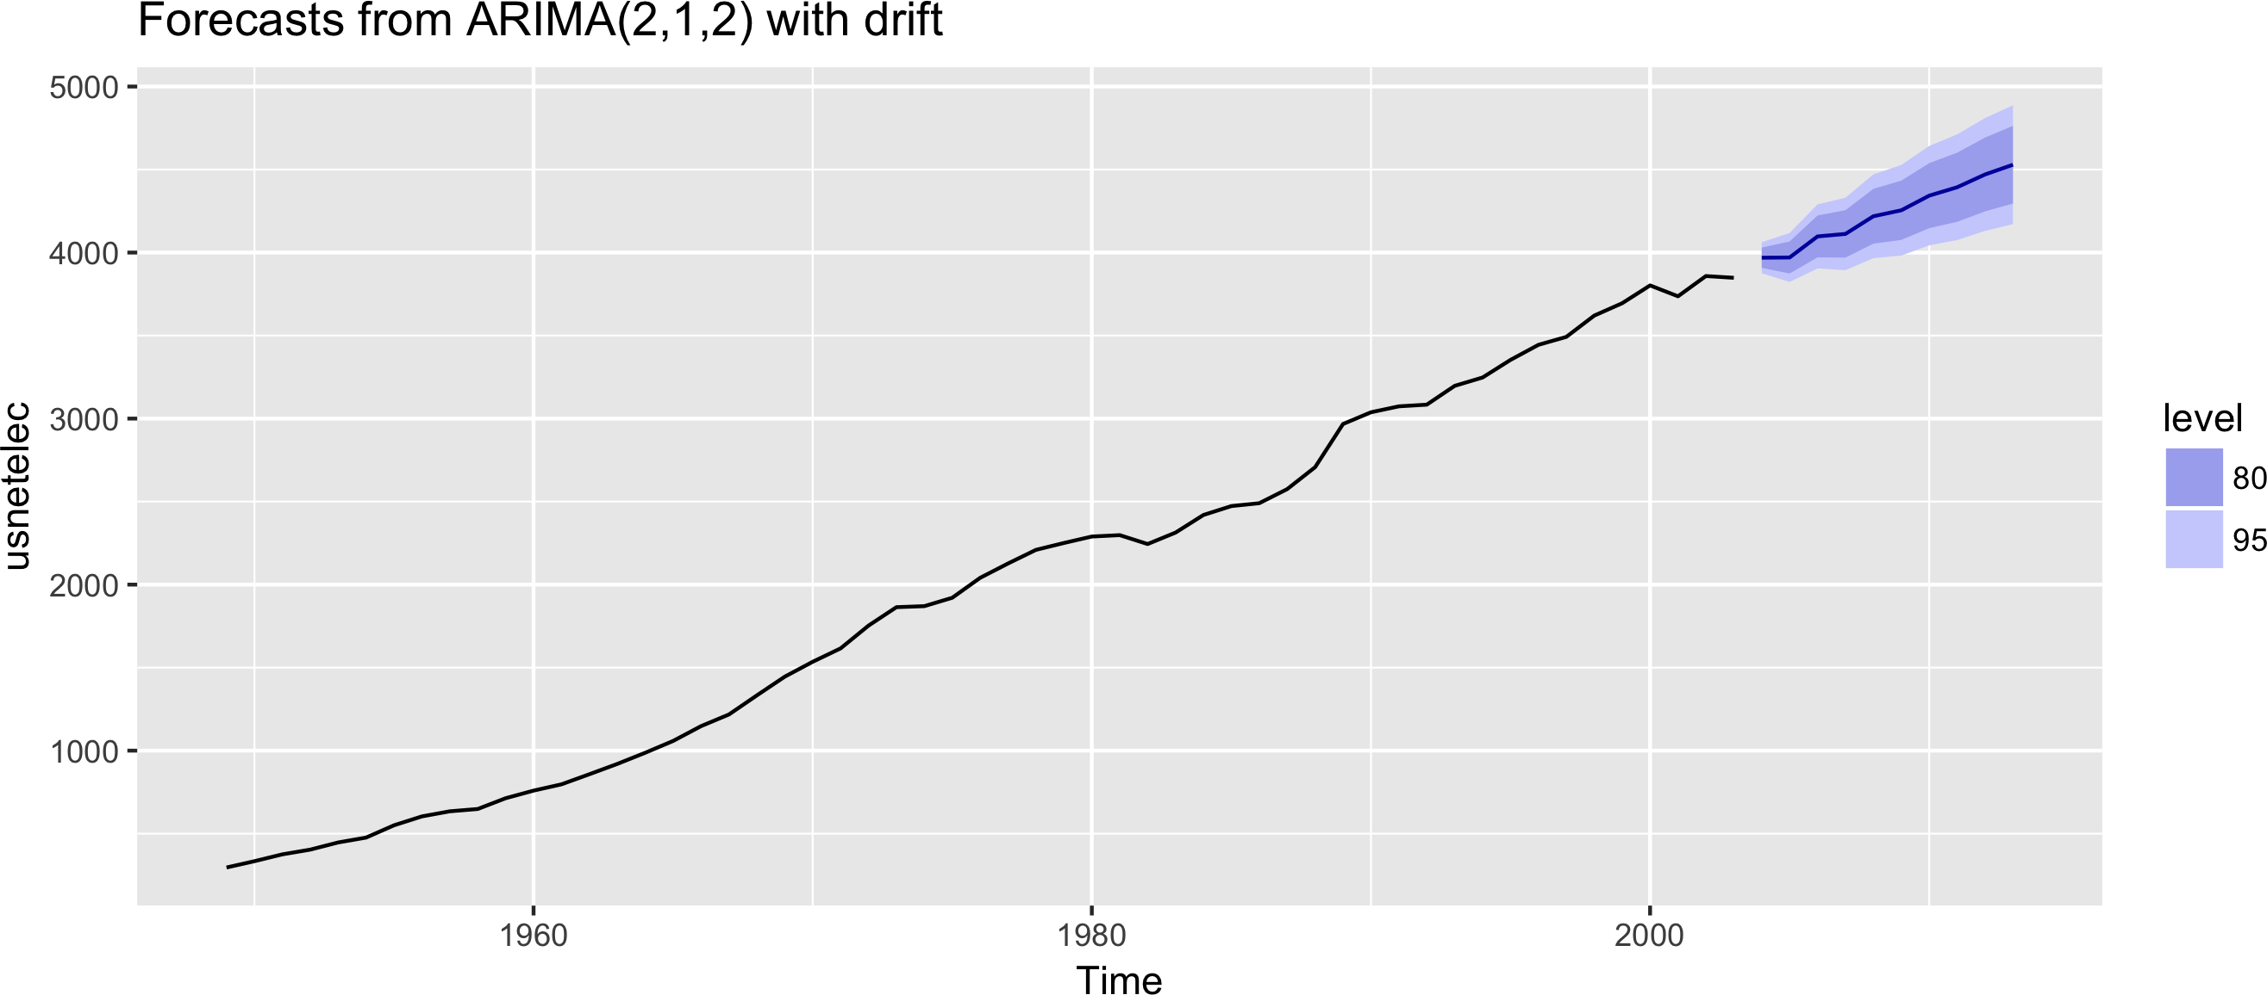
US NET ELECTRICITY GENERATION
fit %>% forecast() %>% autoplot()

Slide 22
HOW DOES AUTO.ARIMA() WORK?
Hyndman-Khandakar algorithm:
Select number of di erences d via unit root tests Select p and q by minimizing AIC_{c}
Estimate parameters using maximum likelihood estimation
Use stepwise search to traverse model space, to save time

Slide 23
Let's practice!
F O R EC A S T I N G I N R

Slide 24
SEASONAL ARIMA MODELS
F O R EC A S T I N G I N R
Z a hid A sg ha r
Professor, School of Economics, QAU

Slide 25
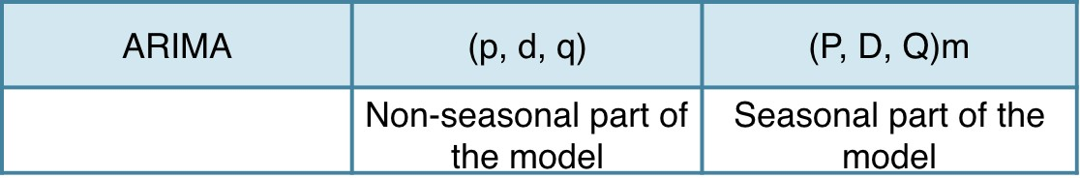
ARIMA MODELS
d = Number of lag-1 di erences
p = Number of ordinary AR lags:
q = Number of ordinary MA lags:

Slide 26
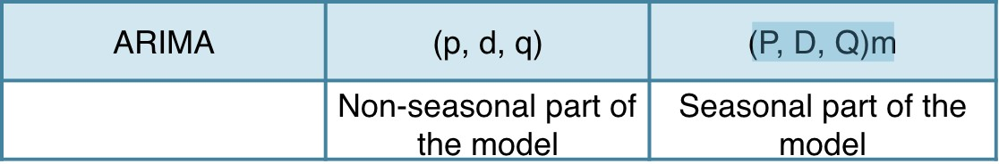
ARIMA MODELS
d = Number of lag-1 di erences
p = Number of ordinary AR lags:
q = Number of ordinary MA lags:

Slide 27
ARIMA MODELS
d = Number of lag-1 di erences
p = Number of ordinary AR lags: y_{t−1}, y_{t−2}, ..., y_{t−p}
q = Number of ordinary MA lags: ϵ_{t−1}, ϵ_{t−2}, ..., ϵ_{t−q}
D = Number of seasonal di erences
P = Number of seasonal AR lags:
yt−m, yt−2m, ..., yt−Pm
Q = Number of seasonal MA lags: ϵ_{t−m}, ϵ_{t−2m}, ..., ϵ_{t−Qm}
m = Number of observations per year

Slide 28
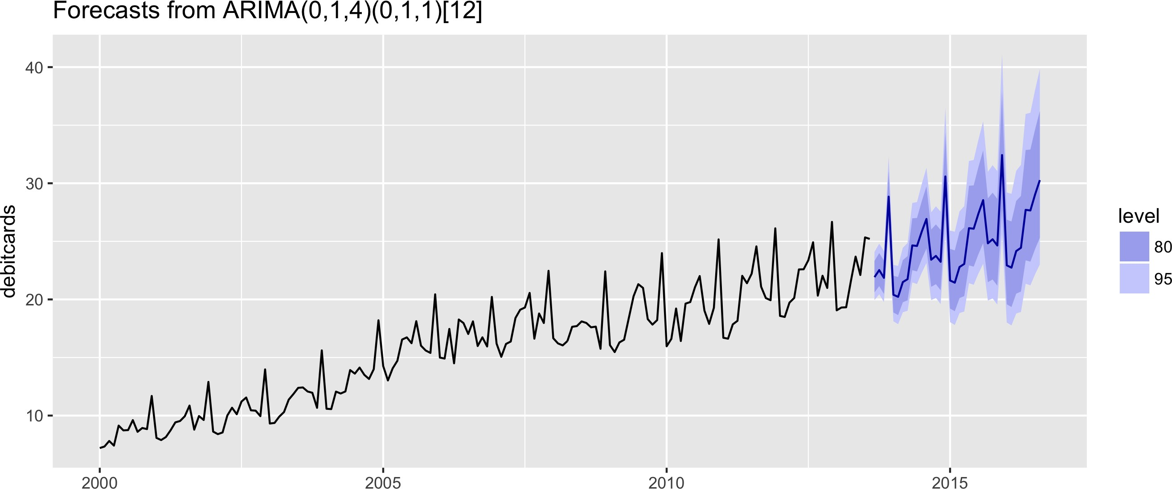
EXAMPLE: MONTHLY RETAIL DEBIT CARD USAGE IN ICELAND
fit %>%
forecast(h = 36) %>%
autoplot() + xlab("Year")
yt−m, yt−2m, ..., yt−Pm

Slide 29
EXAMPLE: MONTHLY RETAIL DEBIT CARD USAGE IN ICELAND
fit <- auto.arima(debitcards, lambda = 0)
fit
Series: debitcards
ARIMA(0,1,4)(0,1,1)[12]
Box Cox transformation: lambda= 0
Coefficients:
ma1 ma2 |  | ma3 ma4 |  | sma1
-0.796 0.086 |  | 0.263 -0.175 |  | -0.814
s.e. 0.082 0.099 |  | 0.100 0.080 |  | 0.112
sigma^2 estimated as |  | 0.00232: log |  | likelihood=239.3
AIC=-466.7 | AICc=-466.1 |  | BIC=-448.6

Slide 30
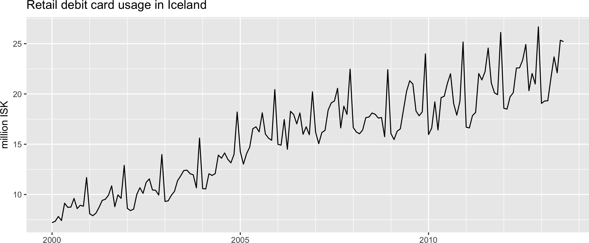
EXAMPLE: MONTHLY RETAIL DEBIT CARD USAGE IN ICELAND
autoplot(debitcards) +
xlab("Year") + ylab("million ISK") + ggtitle("Retail debit card usage in Iceland")
yt−m, yt−2m, ..., yt−Pm

Slide 31
Let's practice!
F O R EC A S T I N G I N R

